Slide 1

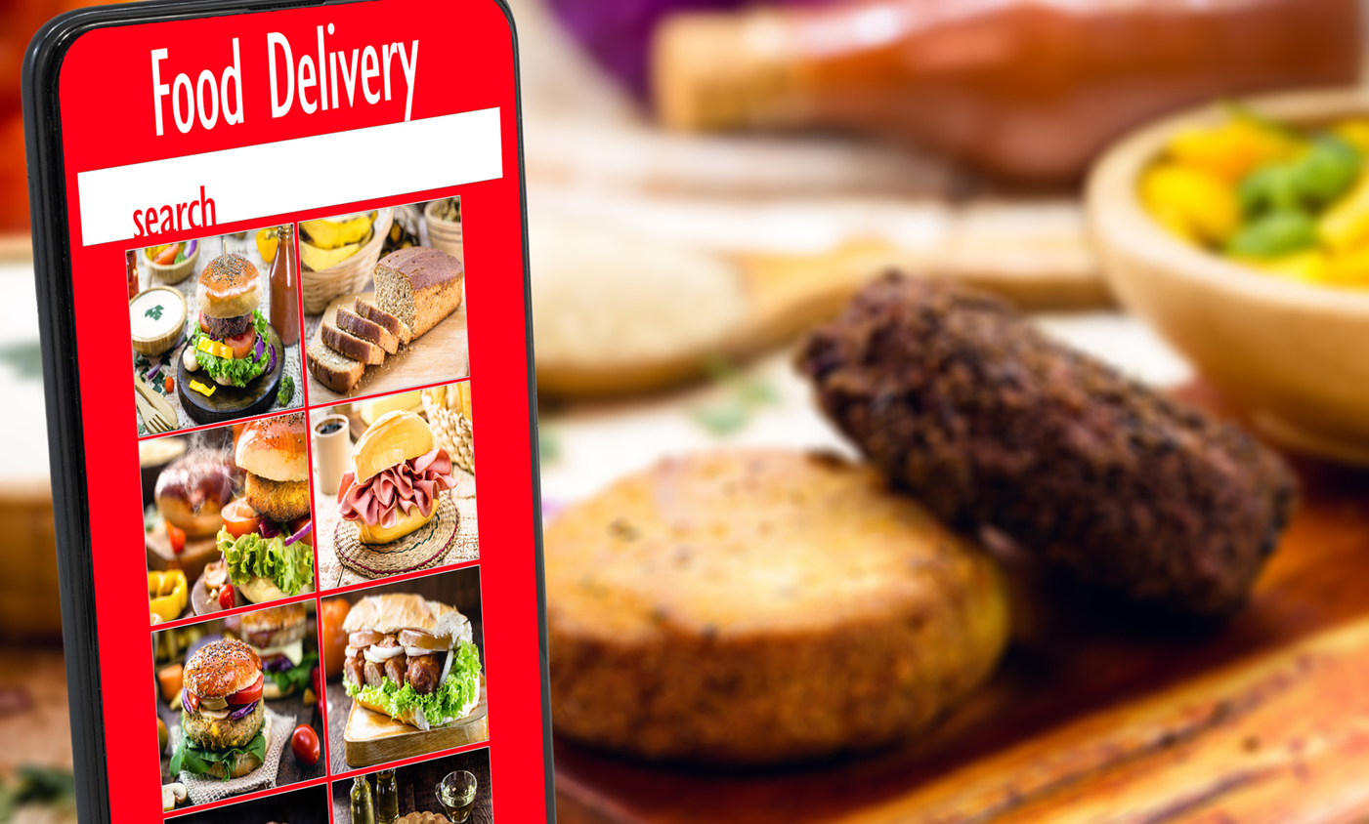


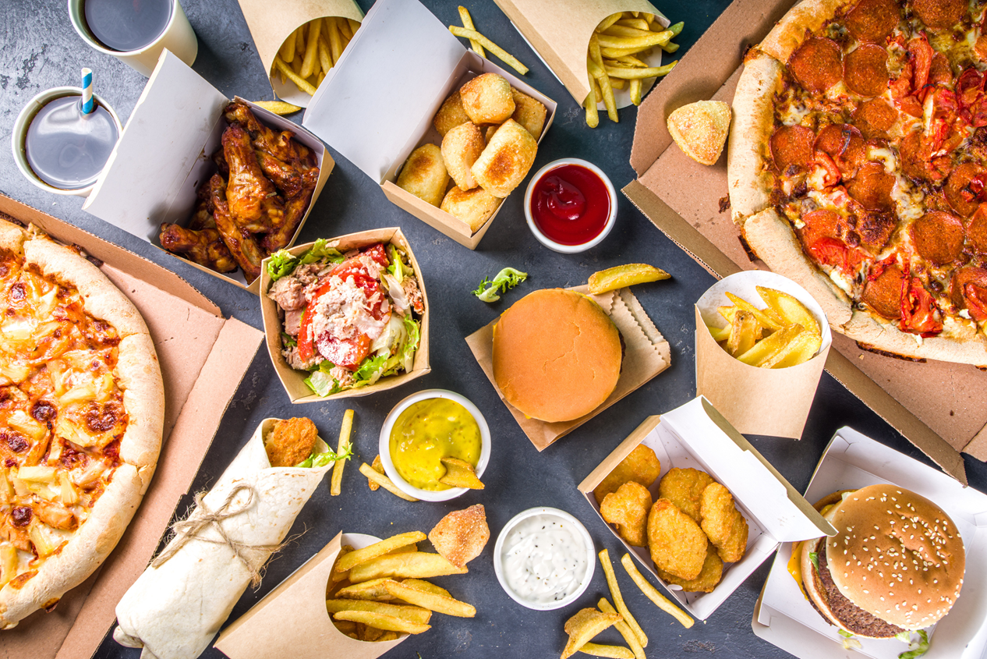
New York City
Optimizing Food Delivery Performance Through Data
Group 9:
Andrew Meza, Christian Molina, Erick Dominguez, Amy Slaton, Jade Russell
Notes:
Andrew

Slide 2
Objective
Analyze Food delivery data for trends and performance
Load and manage data in PostgreSQL
Generate actionable insights using SQL queries
Notes:
Andrew
Talking Points:
State the project objectives:
Analyze food delivery trends.
Load and manage data using PostgreSQL.
Generate actionable insights through SQL queries and EDA in Python.
Highlight the importance: "This analysis aims to help restaurants optimize operations and customer retention."

Slide 3
Data Sources and Tools
Data: Food orders and restaurant information (CSV files)
Tools Used
Python: Pandas, NumPy, SQLAlchemy
PostgreSQL and pgAdmin
Dataset Overview:
Number of Records: 1898
Key Columns: 9
Notes:
Add Dataset preview to bottom of slide
Talking Points:
Data sources:
"The dataset consists of food order records, including restaurant details."
Example: 1898 records and 9 key columns.
Tools used:
"Python libraries like Pandas and SQLAlchemy were used for data manipulation."
"PostgreSQL and pgAdmin handled database tasks."
Provide a quick look at the data structure:
Columns include order IDs, timestamps, cuisine types, etc

Slide 4
Data Cleaning and Transformation
Imported CSV Files into Pandas DataFrames
Transformed data for PostgreSQL combability
Performed Data Cleaning
Handled Missing Values
Corrected Data Types
Removed Duplicates
Notes:
Talking Points:
Walk through the steps:
"Loaded raw CSV data into Pandas DataFrames."
"Handled missing values, corrected data types, and removed duplicates."
Example: Show before-and-after summaries or describe key changes in column types.
Emphasize challenges:
"Managing inconsistencies in restaurant names and missing timestamps was crucial."

Slide 5
PostgreSQL Integration
Database tables created
Restaurants
Orders
Process for loading data
Python libraries: SQLAlchemy, psycopg2
SQL Queries for validation
Notes:
Use screenshots of tables or code snippets
Talking Points:
Explain the integration process:
"Created database tables for restaurants and orders in PostgreSQL."
"Used SQLAlchemy and psycopg2 for seamless data transfer from Python."
Mention validation queries:
Example: SELECT * FROM restaurants;
Highlight advantages: "Storing data in PostgreSQL ensures scalability and faster querying."

Slide 6
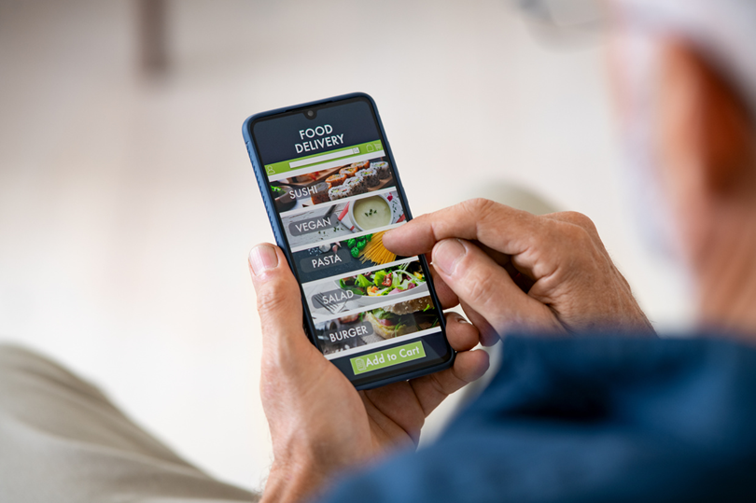
Exploratory Data Analysis (EDA)
Identified trends in food orders
Most ordered cuisines
Peak Delivery Times
Top-performing restaurants
Notes:
Add barcharts
Talking Points:
Share visualizations from the notebook:
"Identified the most ordered dishes and peak delivery times."
"Analyzed top-performing restaurants based on order frequency."
Discuss key observations:
Example: "Italian cuisine accounted for 30% of all orders."

Slide 7
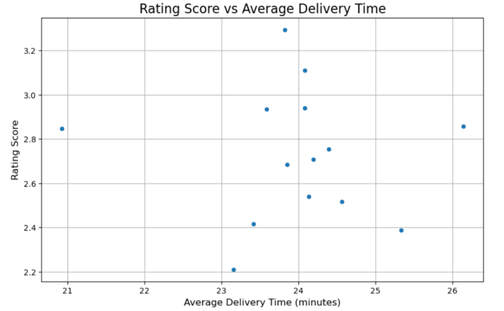

Slide 8
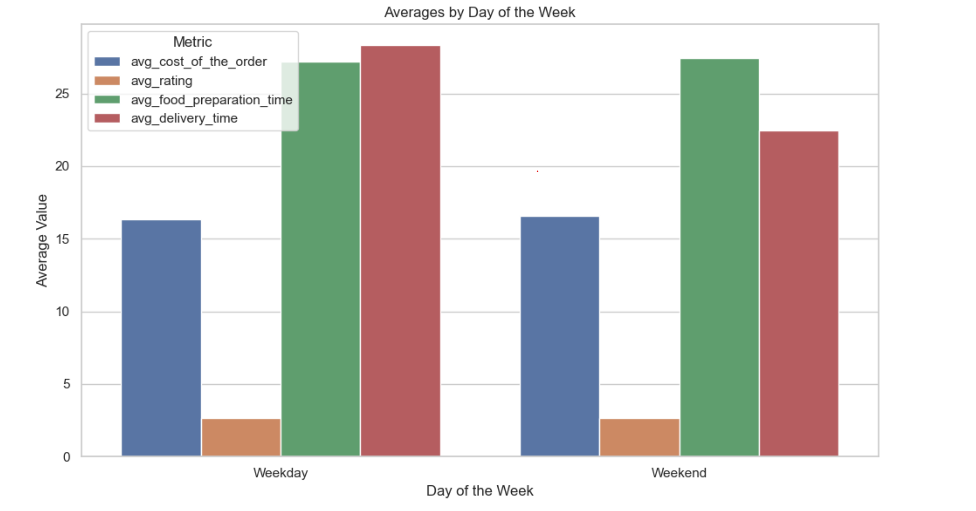

Slide 9
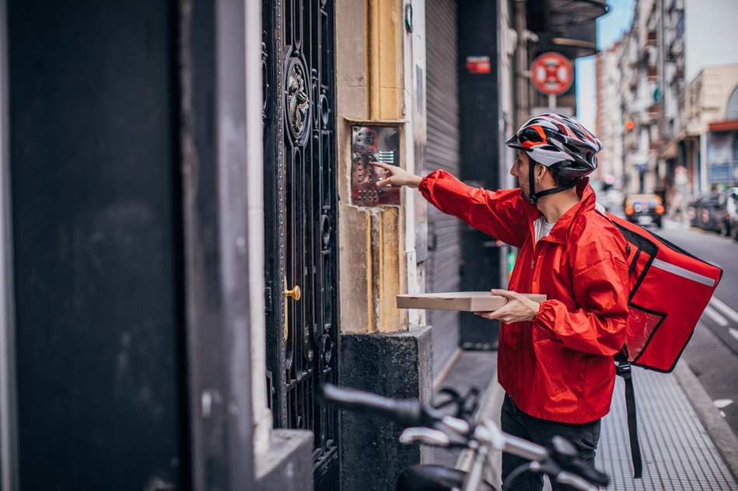

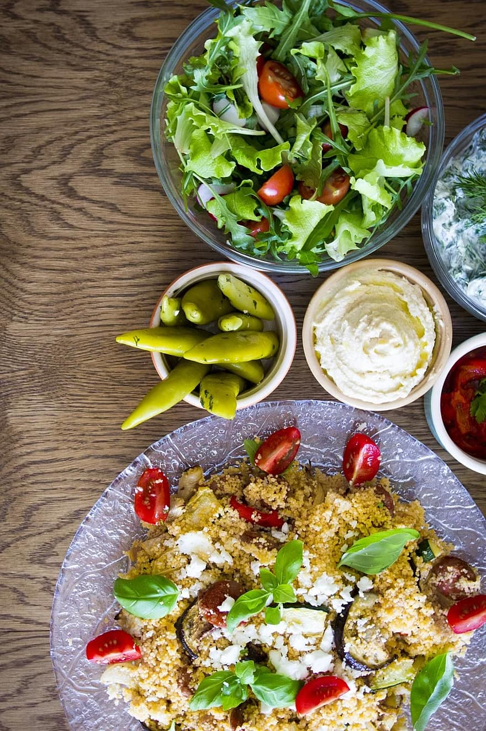
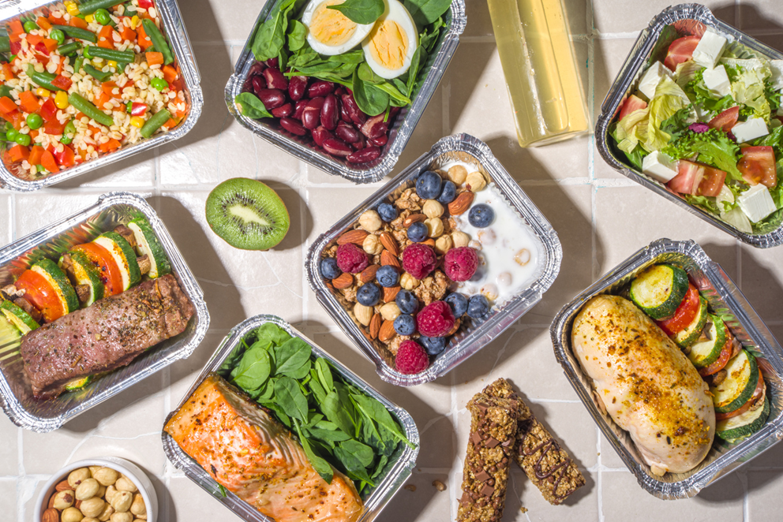
Recommendations
Expand marketing efforts during peak times
Focus on popular
dishes for promotions
Improve delivery efficiency for high-demand periods
Notes:
Add rationale
Talking Points:
Expand marketing during peak times: "Focus on weekends to maximize ROI."
Promotions: "Highlight popular dishes, like Italian cuisine, in campaigns."
Operational improvements: "Streamline delivery operations for high-demand hours."

Slide 10
Challenges and Learnings
Data cleaning complexities
Optimizing PostgreSQL queries
Key takeaways from the project
Notes:
Andrew
Talking Points:
Challenges:
"Dealing with inconsistent data formats and missing values."
"Optimizing SQL queries for faster performance."
Learnings:
"Gained hands-on experience with PostgreSQL and data cleaning techniques."

